Slide 1
2645 Game presentation
James, Abasibiangake
GROUP NO: 13
PERSONAL ID: 1
201191089.

Slide 2
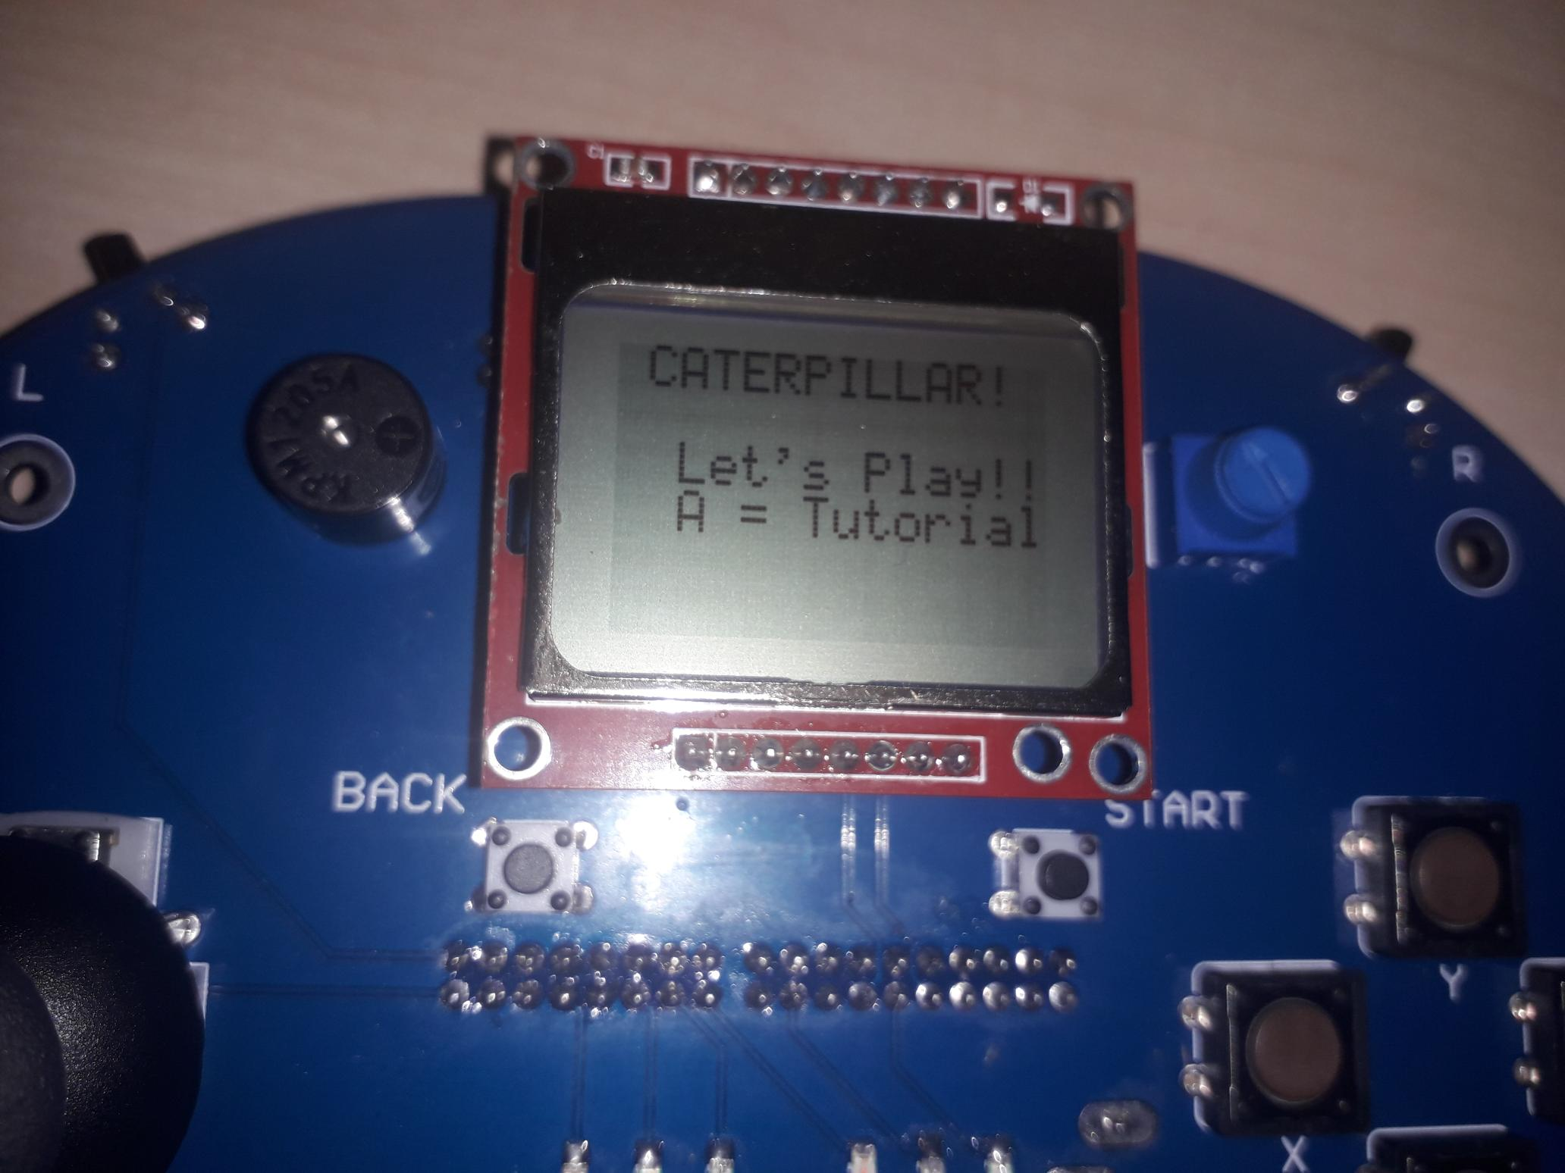
Introduction to caterpillar game.
The game made for my project was a caterpillar game.
It was inspired from the snake game.
This game involves the movement, feeding and growth cycle of the caterpillar.
It consist of a predator, caterpillar, food, life and age.
It is a simple game that is easy to understand.

Slide 3
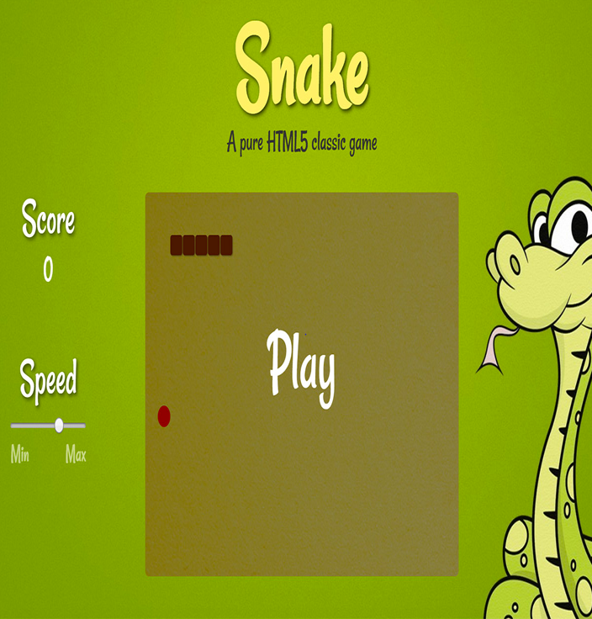
Rationale For Choosing Game
The snake game has the following features which influenced my choice:
Simplicity.
Easy to understand and program.
User friendly interphase.
Enticing/Addictive
Can be easily made using C++ language.

Slide 4
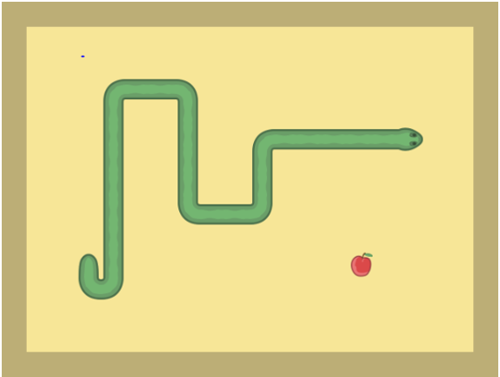
Features of snake game
The Caterpillar Game was inspired by the Snake Game.
The main objective of the Snake game is to increase the length of the snake as it eats the food.
There are difficulty levels in the game: Easy, medium and hard level.
The Snake game also has two gaming arena: Unbounded and bounded arena.

Slide 5
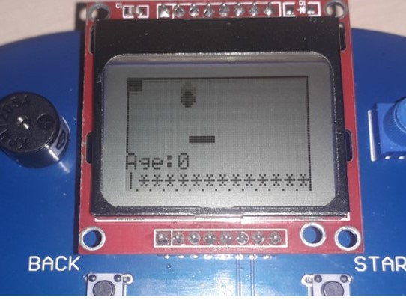
Overview of Caterpillar game
The main objective of this game is ensure that the caterpillar eats all the available food (square).
The caterpillar is expected to dodge the predator (circle) in the process.
When the caterpillar is older than 10 years, it will develop into a butterfly.
Level up
Caterpillar losses its life(LEDs) by hitting wall or being eaten by the predator.

Slide 6
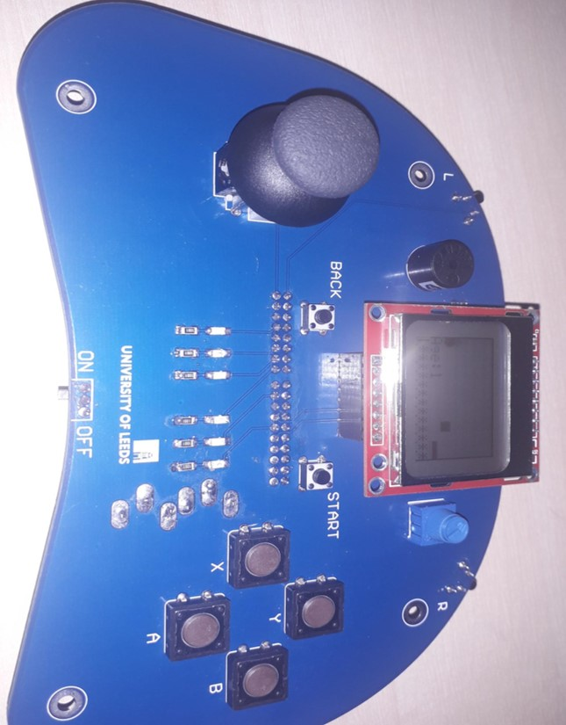
Components used For the Game.
LEDs.
Joysticks.
Buttons.
Start.
Back.
LCD.
Magnetic buzzer.

Slide 7
How to Play.
Press the instructed buttons to go through the tutorial of the game.
Press START to begin the game.
Press BACK to restart the tutorial.
Move the joystick around to control the direction of the caterpillar.

Slide 8
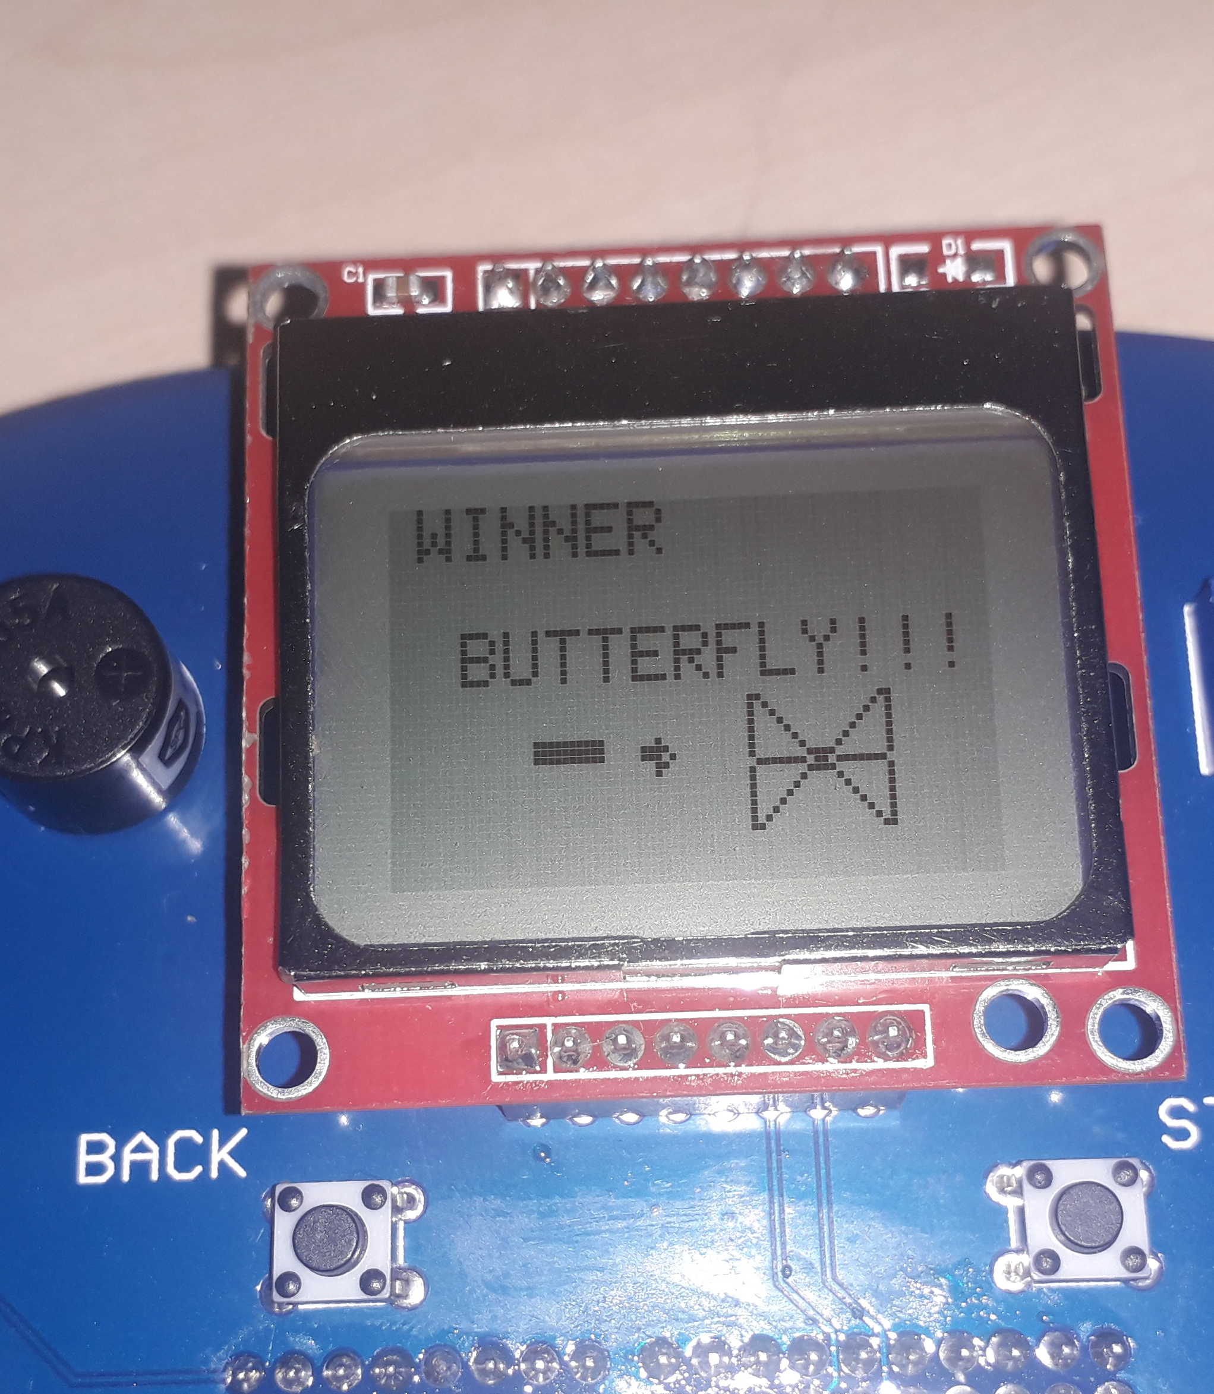
Uniqueness of The Caterpillar Game.
Originality of the caterpillar game.
The Butterfly stage of the caterpillar.
Adding an predator which bounces to attack the caterpillar.
Controlling the life of the caterpillar with LEDs.

Slide 9
Implementation difficulty
While programming the caterpillar game, the part I found most difficult to implement was:
the “check for when predator eats the caterpillar” because of the shape of the predator.
and the control of the caterpillar’s life through the LEDs.

Slide 10
Extra Features.
More component usage.
Addition of the unbounded arena.
More features to restore or increase the life of the caterpillar.
More levels.

Slide 11
Thank you.

